Slide 1


Default Risk
Prediction Model of P2P Online Lending
Xiaoxuan Wang
Shirui Du(Institute of Economics)
Shuqing Ao(Institute of Economics)
Bin Gao(School of Management)

Slide 2

Contents
01
Project Introduction
02
Model Analysis

Slide 3
PART 01
Project Introduction

Slide 4


What is P2P Online Lending ？
borrowers
Platform
lenders
Have funding needs and announce the loan interest rate they can afford
Providing services to both borrowers and lenders
act as an intermediary in the process
Charge service fees
Select borrowers with high interest rates and good credit to provide financial support

Slide 5

Why Study This Topic?
Information Asymmetry
Lenders cannot physically vet borrowers like a bank would, making it difficult to judge if the borrower will repay on time.
Reducing Default Rates
If you can predict who is likely to default (e.g., based on their spending habits, social data, past repayment behavior), the platform can reject these high-risk applicants or demand a higher interest rate to cover the risk.
the platform absconds with the money
Due to a lack of supervision, the platform may embezzle funds.

Slide 6

We May
Analyze how user behaviors affect loan default risk on credit platforms
Build a basic risk assessment model for P2P platforms to evaluate customer borrowing reliability and reduce default risk
Provide risk warning signals for P2P platforms to assist manual review and post-loan management decisions

Slide 7
PART 02
Model Analysis

Slide 8
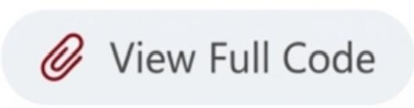
Analytic Roadmap
1.Data Preprocessing & Quality Diagnostics
2.Handling Class Imbalance
3.Modeling Strategy
4.Model Performance & Comparison
5.Performance Gap Analysis
6.Feature Engineering Reflection
7.Clustering Analysis
8.Limitations, Conclusions & Future Work

Slide 9
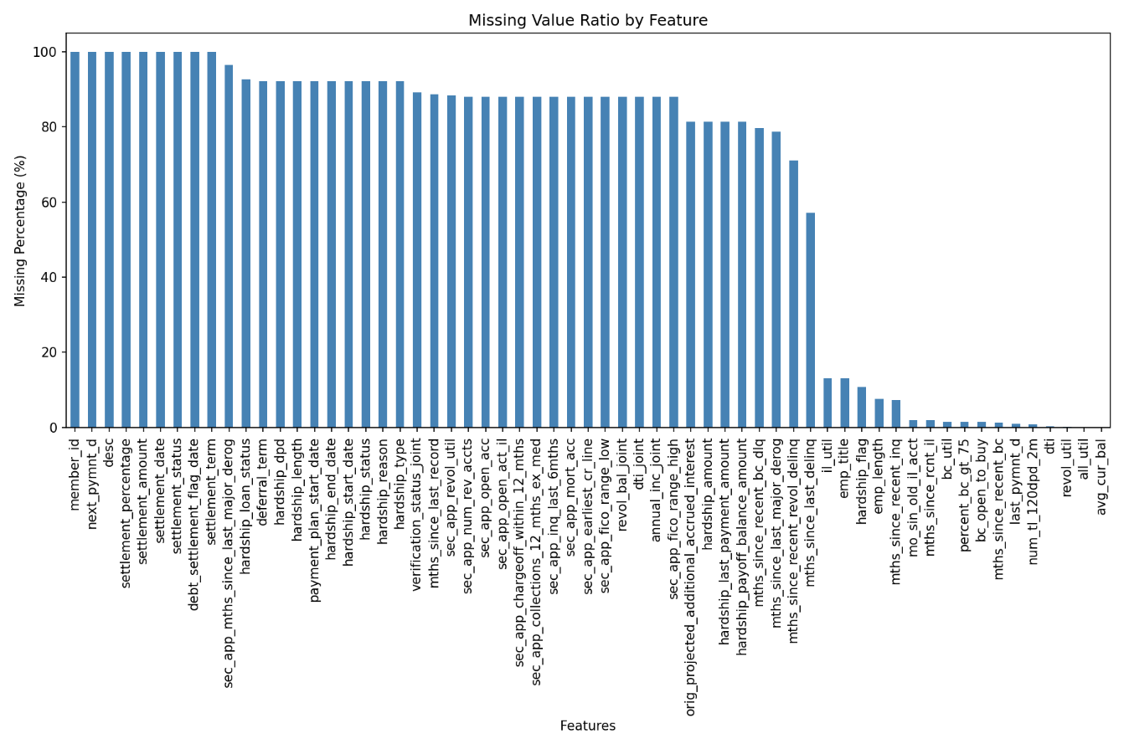
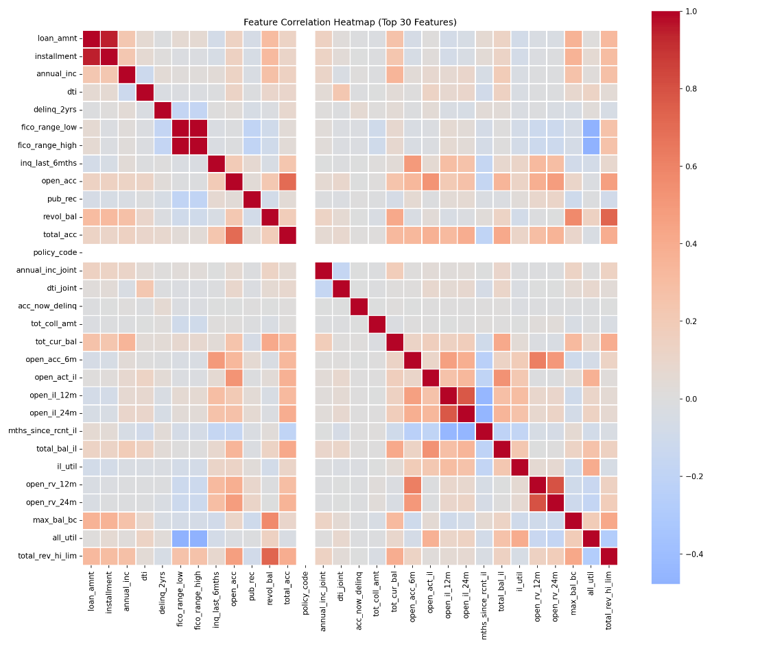
Data Quality Diagnostics
Missing data is heavily concentrated in optional, non-critical borrower fields.
Low multicollinearity among key predictors

Slide 10
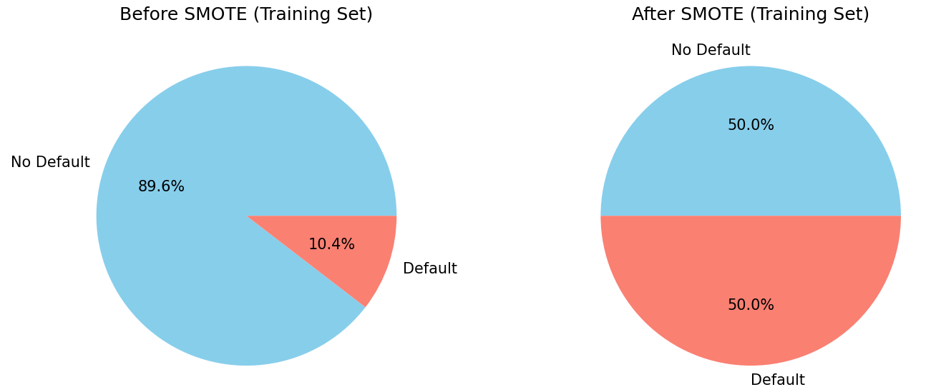
Data Processing
1.Data Source
The dataset used for the default prediction model is the borrower transaction data of Lending Club from Q4 2019 to Q3 2020.
2.Processing method
Imbalanced data is processed using the SMOTE algorithm.

Slide 11
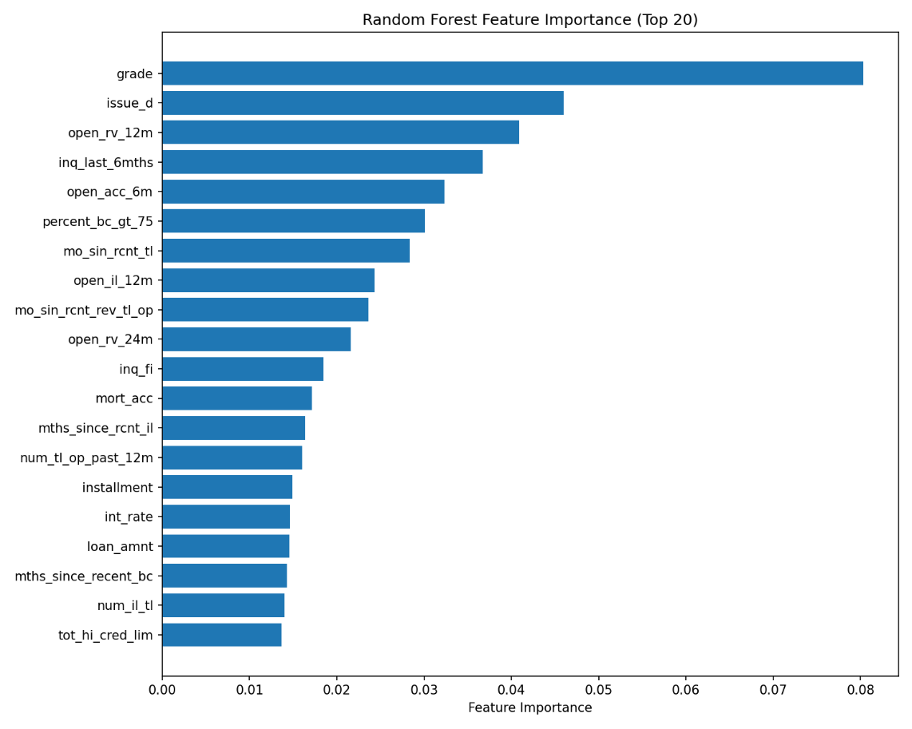
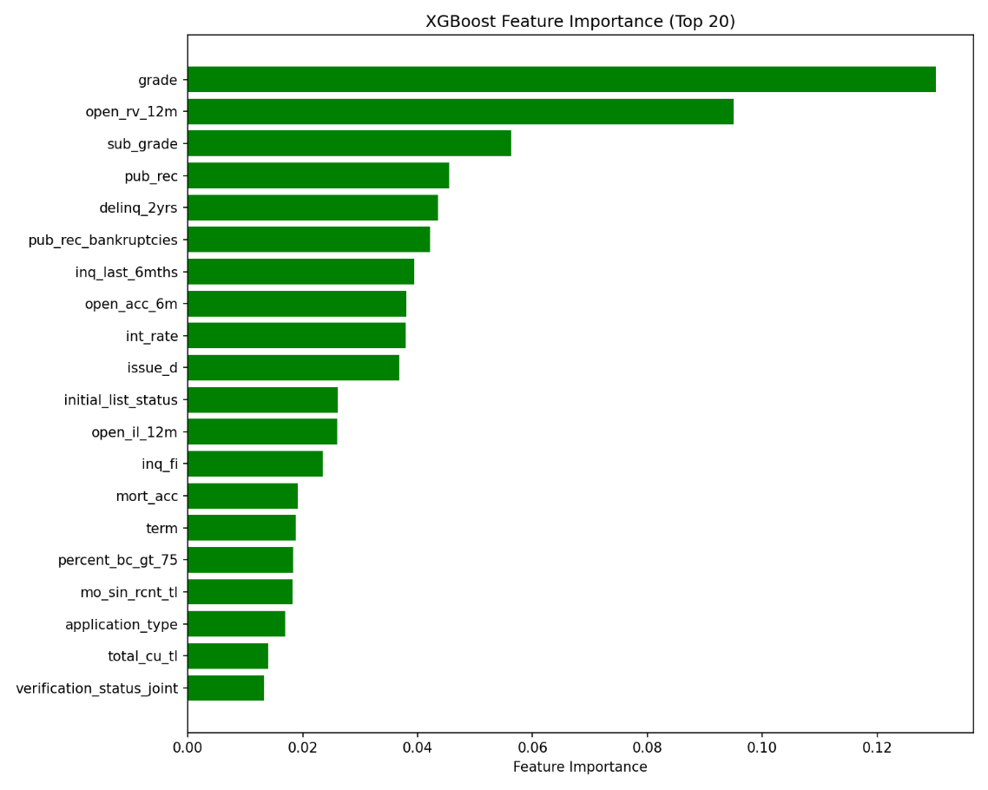
Feature Importance Insight
Feature selection keeps only the most relevant features, removing noise to simplify training and boost model generalization.
Among all variables, credit rating (grade) is the most critical for predicting default, while behavioral features like DTI and Total Credit add finer risk detection.

Slide 12
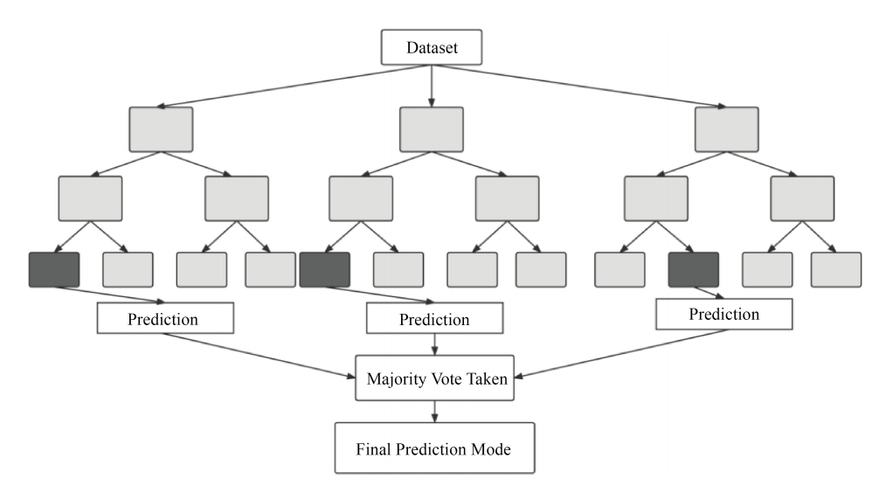
Model Introduction
Model 1: Random Forest (RF)
Random Forest (RF) is an extension of Bagging. It builds a Bagging ensemble using decision trees as base learners and further introduces attribute selection during the training process of the decision trees. Compared with a single decision tree algorithm, random forest eliminates many limitations, reduces overfitting on the dataset, and provides a way to handle missing data, thereby improving accuracy.
The specific algorithm is shown in the following figure：

Slide 13
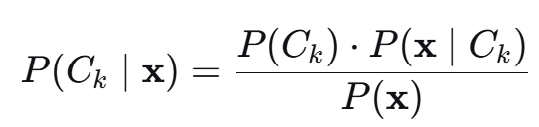
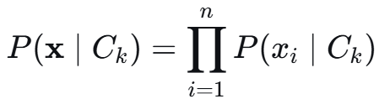
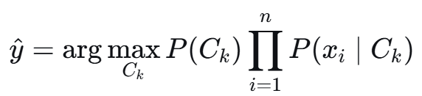
Model 2: Naive Bayes
Core idea: Calculate the posterior probability of each category given the features, and select the category with the highest probability as the prediction result.
(1)Bayes’ Theorem
For a class C_{K} and a ferture vector x=(x₁,x₂,...,x_{n}),Bayes’ theorem gives the posterior probability:
P(C_{K}|x):posterior probability
P(C_{K}):prior probability
P(x|C_{K}):the probability of observing x given class C_{K}
P(x):evidence – constant across all classes and can be ignored for classification
(2)Naive Conditional Independence Assumption
All features are mutually independent given the class:
(3)Classification Decision Rule

Slide 14
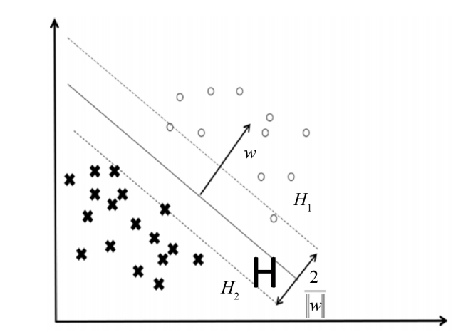
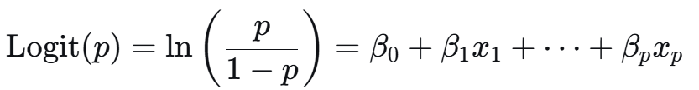
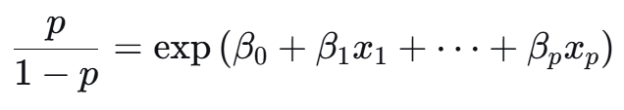
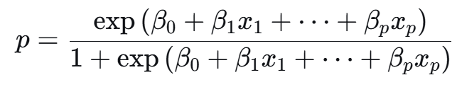
Model 3: Logistic Regression
The dependent variable Y in the study is the loan status
Y=1: defaulters
Y=0: non-defaulters
The probability of Y=1 is assumed to be P.
Model 4: Support Vector Machine, SVM
The core objective is to find an optimal hyperplane in the feature space to separate data points of different classes
As shown in the figure : and represent two classes of samples, w represents the normal vector of the hyperplane,
H₁ and H₂ are the upper and lower boundaries, with a margin of 2, w representing the margin distance, and H being the optimal separating hyperplane.

Slide 15
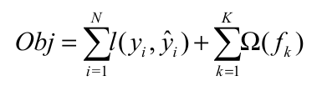

Model 5: XGBoost
The XGBoost algorithm is developed from the GBDT method. It is an ensemble of trees that makes output predictions using a cumulative approach.The objective function of the XGBoost algorithm is
is a differentiable convex loss function used to measure the discrepancy between the predicted value and the target value, known as the empirical risk.
is a penalty term for model complexity, known as structural risk, which helps reduce the risk of overfitting and makes the learned model parameters smoother.

Slide 16
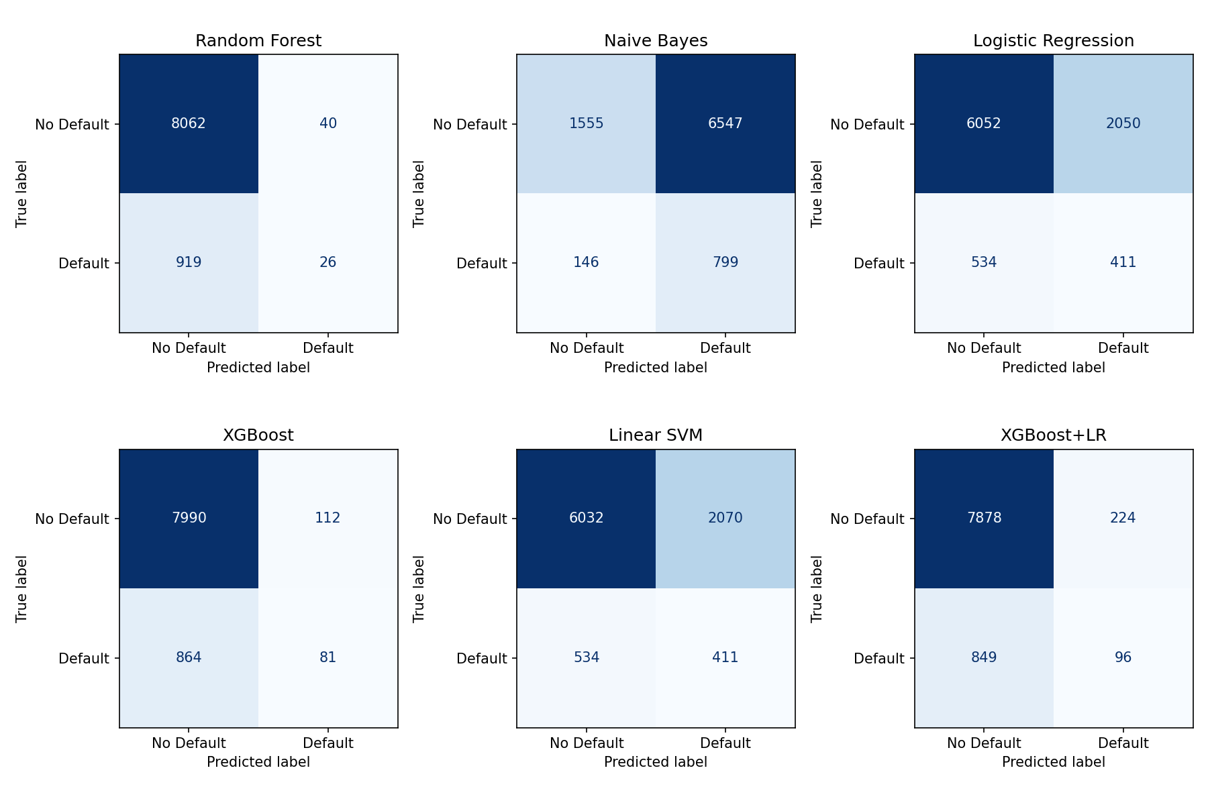
Confusion Matrices
Confusion matrix:
clear view of errors on imbalanced data.
XGBoost:
81 true defaults,
864 missed,
7,990 true repayments,
112 false alarms
→ best risk detection & lowest errors.

Slide 17
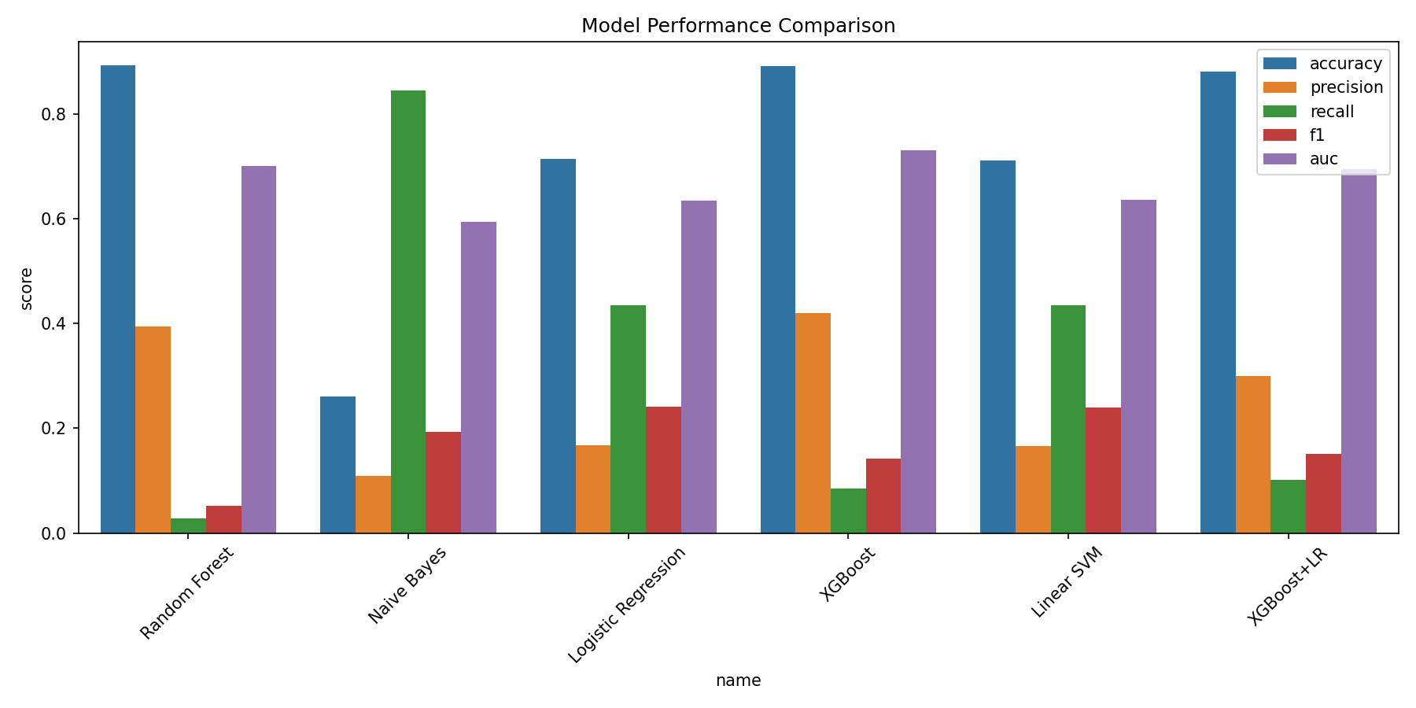
Model Performance Comparison
XGBoost achieved the superior macro-performance with an AUC of 0.7309 and an Accuracy of 0.8921.

Slide 18
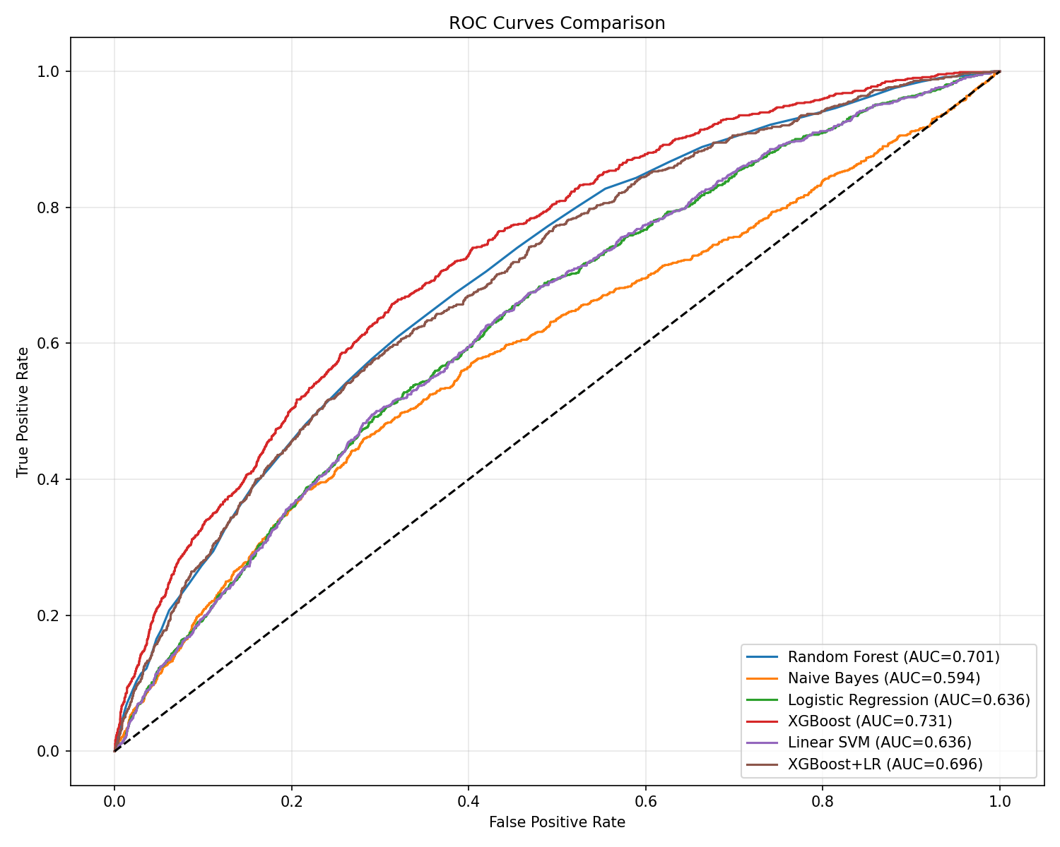
Model Performance Comparison
The XGBoost model completely encloses the other three classifiers, and its AUC value is the largest, indicating XGBoost outperforms all others.

Slide 19

Performance Gap Analysis
Why did the expected AUC relatively low (below typical production threshold 0.8) ?
1. Over-removal of features: to enforce strict reality without look-ahead bias
2. SMOTE noise: injecting synthetic data into a complex behavioral space
3. Encoding choice: limitations inherent to frequency encoding
4. COVID-19 period: unprecedented macroeconomic anomalies in the time window

Slide 20

Feature Engineering Reflection
Removing last_fico, mths_since_last_delinq, and recoveries is
mathematically painful but practically necessary. Retaining them
creates look-ahead bias, rendering the model completely
useless for real application.

Slide 21
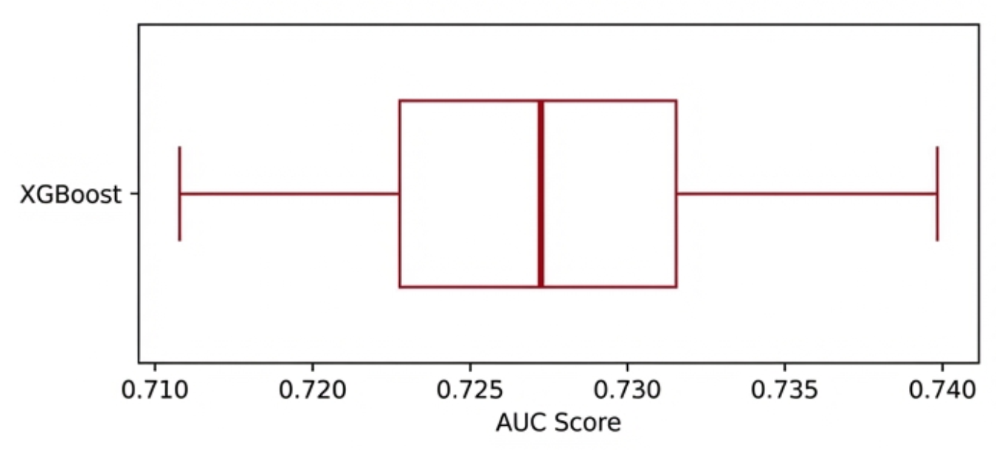
Cross-Validation Stability
The 5‑fold cross‑validation results show almost no variation, confirming that the 0.731 AUC is stable and not just a random fluke of how we split the data.

Slide 22
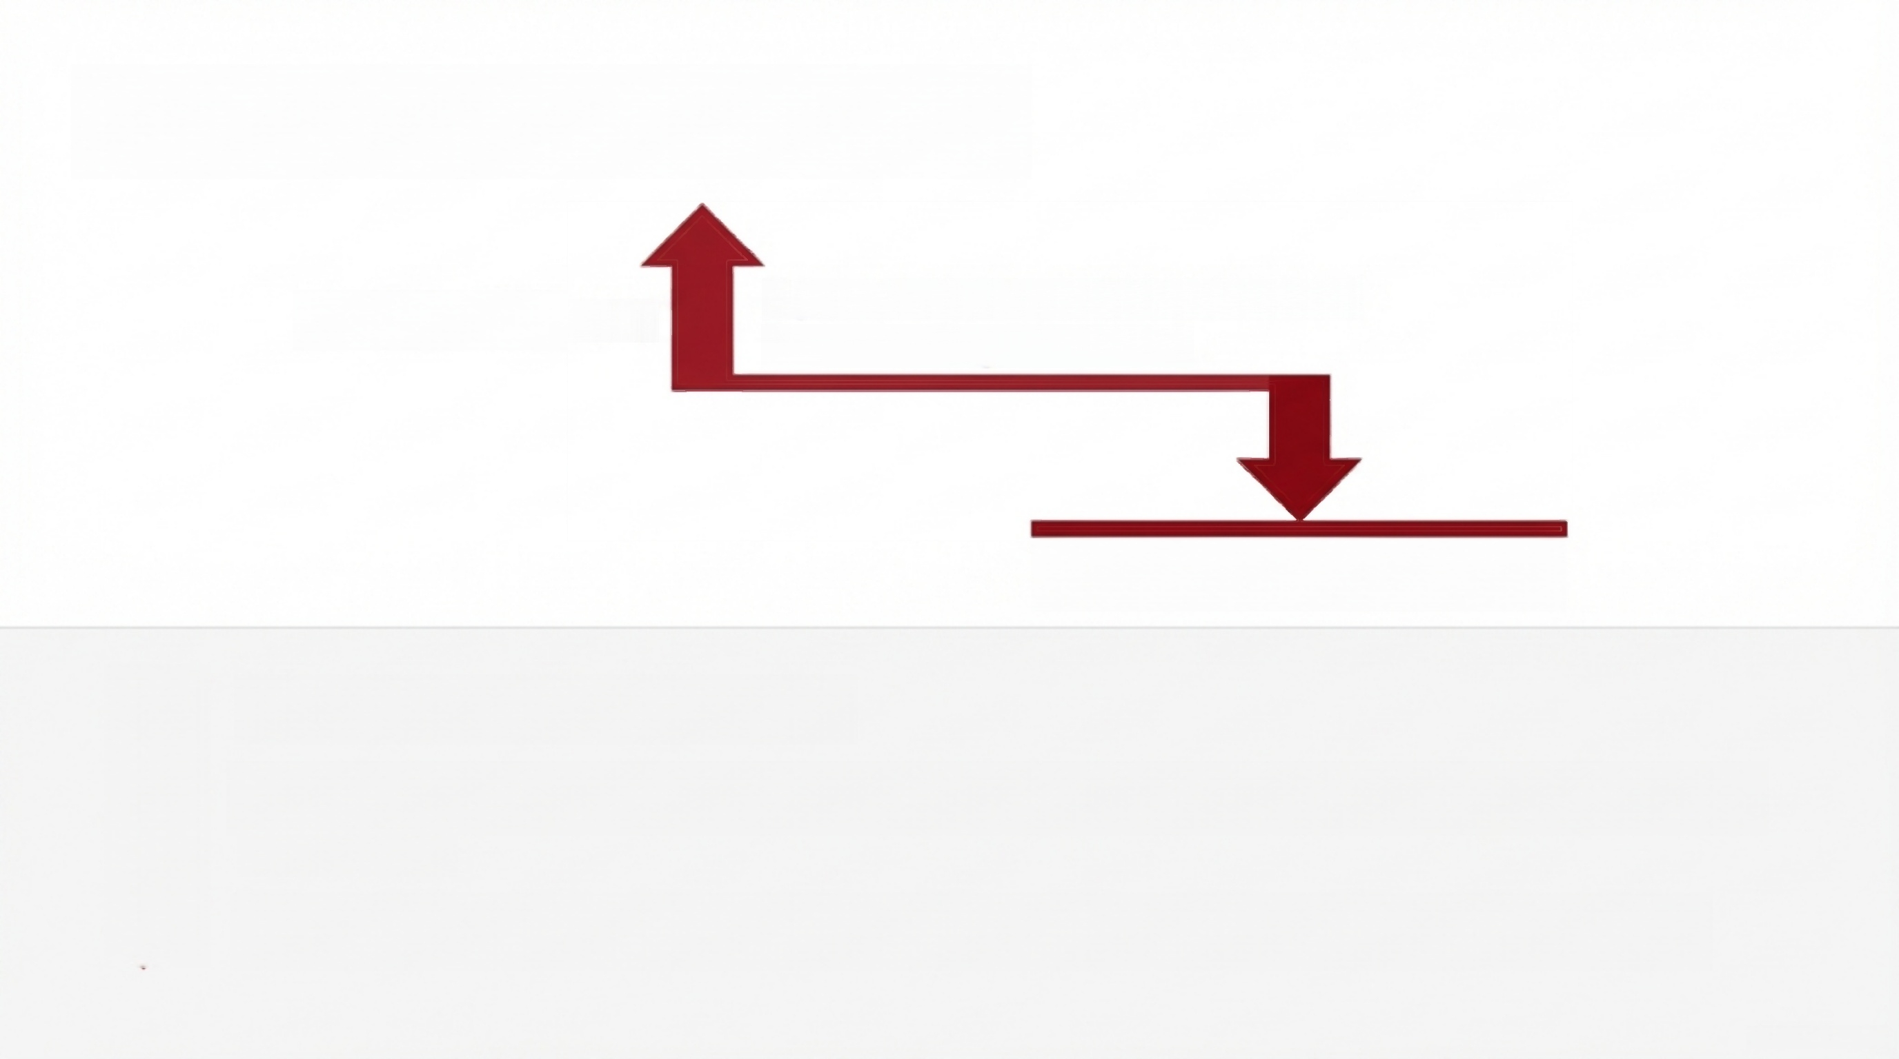

Comparative Experiment
If post-loan features were retained (Data Leakage Allowed)
Artificial High AUC
Realistic Baseline: 0.731 AUC
Pipeline is successfully complete.
XGBoost (AUC = 0.731) provides a highly realistic, look-ahead bias-free baseline for actual production.
The model is primed for actual production scaling, free for historical data leakage.

Slide 23
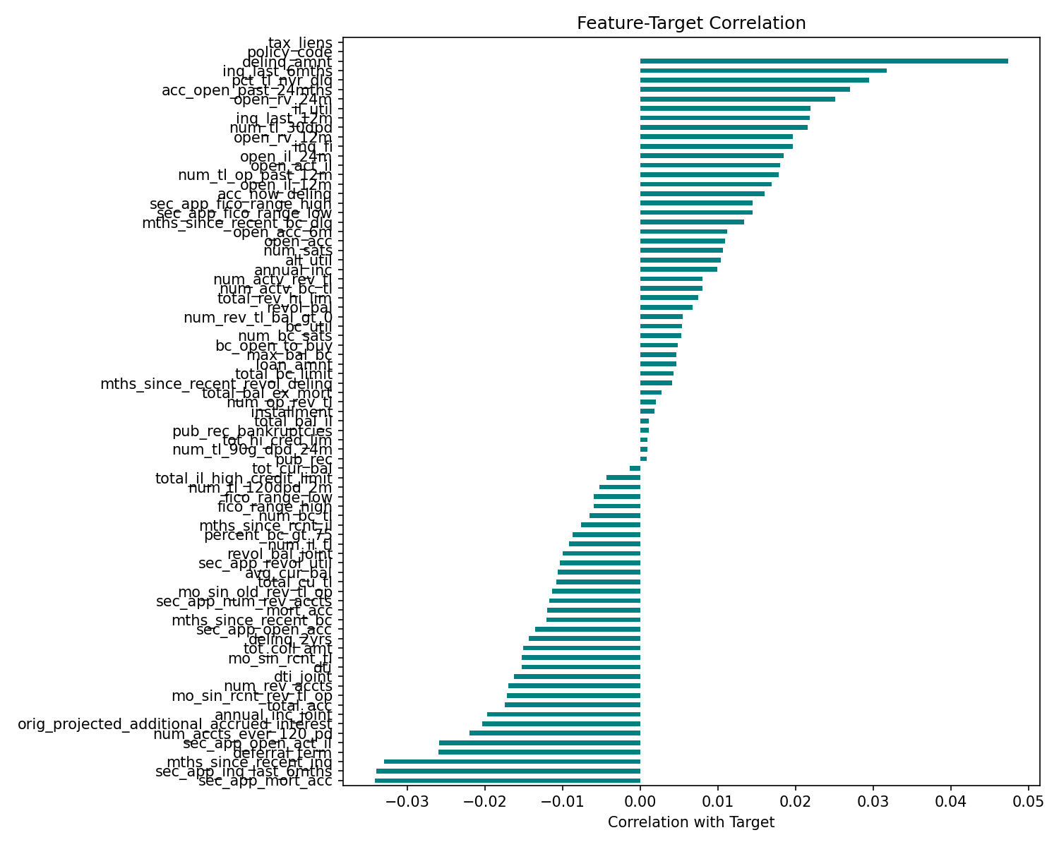
Feature-Target Correlation
Linear correlations are low across features, proving the absolute necessity of non-linear tree models (like XGBoost) to capture complex behavioral patterns.

Slide 24
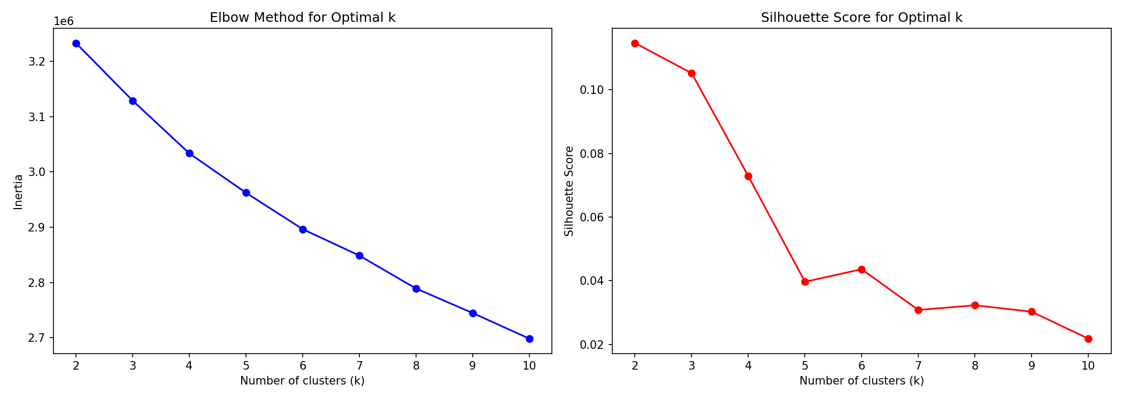
Clustering Analysis I: K-Means
While inertia drops steadily, the silhouette metric definitively identifies k=2 as the optimal mathematical boundary for clustering borrower archetypes within the feature space.

Slide 25
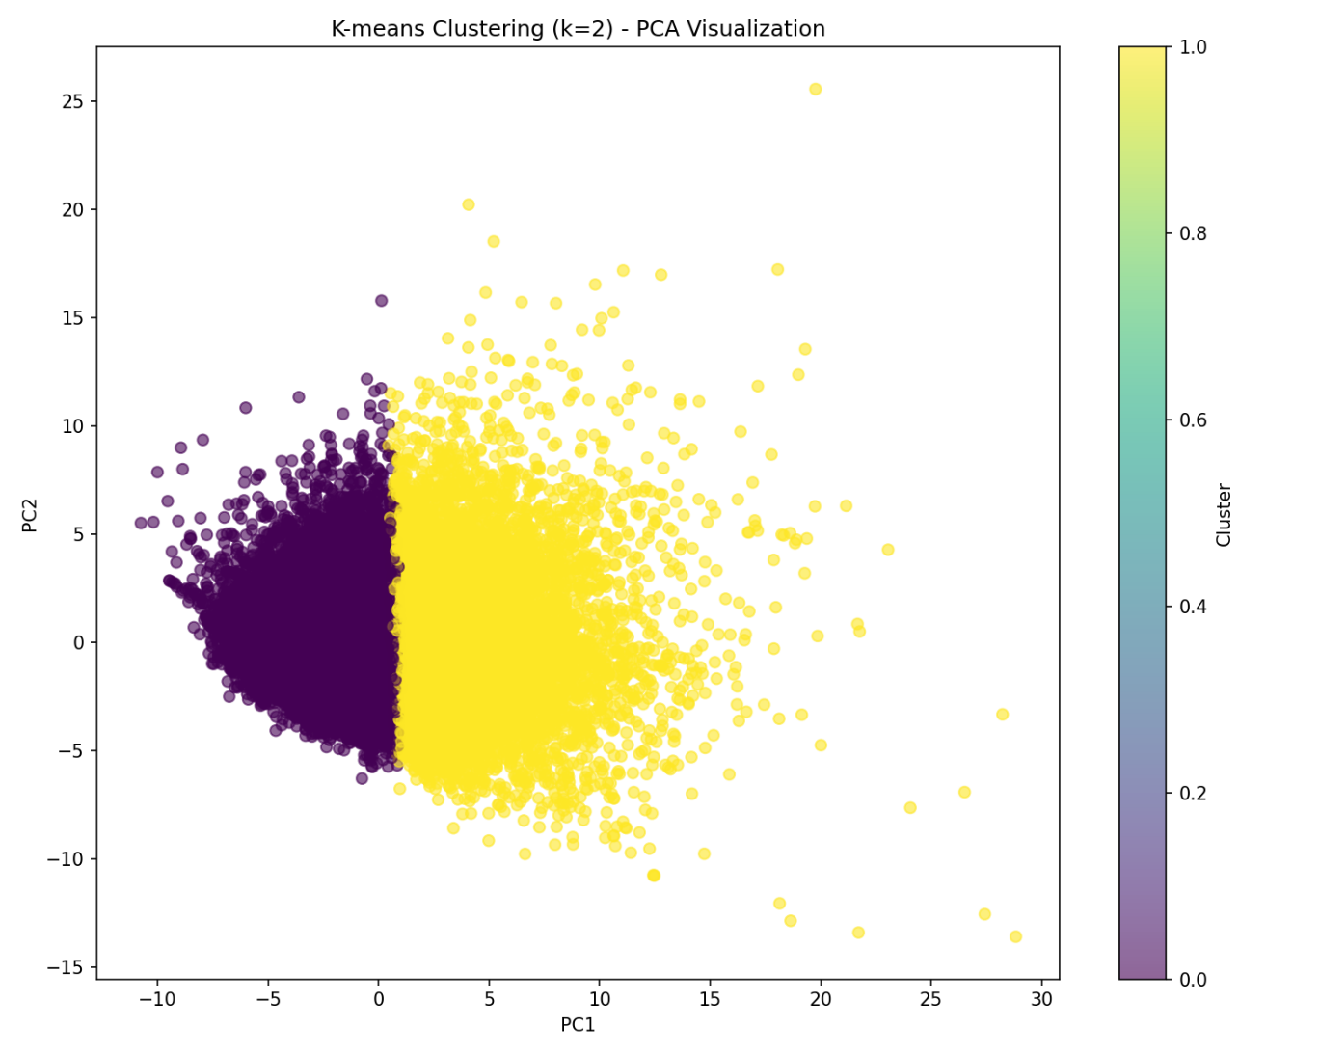
Clustering Analysis II: K-Means
-5 0 5 10 15 20 25 30
The 2D visualization confirms distinct, natural segmentations within borrower behavioral data.

Slide 26

Limitations
1. COVID‑19 Anomaly: dataset spans unique pandemic period (stimulus, distorted defaults) → limits generalizability.
2. Signal Attrition: removing post‑loan features prevents look‑ahead bias but sacrifices predictive signal → caps achievable AUC.
3. Moderate AUC: 0.731 is below typical production threshold (≥0.8) for financial risk models.
4. Tree Interpretability: XGBoost lacks individual per-prediction transparency.
5. Synthetic Noise: SMOTE may introduce noise in complex behavioral patterns (time‑series context).

Slide 27

Conclusion
End‑to‑end pipeline established: robust preprocessing, imbalance handling, multi‑model evaluation.
Best model identified: XGBoost (AUC = 0.731) provides realistic, look‑ahead‑bias‑free baseline.
Clustering insights: K‑Means reveals customer segments, enabling future dynamic risk tiering.

Slide 28






Future Work
1. Expand data window: include pre‑COVID & post‑COVID periods.
4. SHAP interpretation: apply Shapley values for individual per‑prediction explanations.
2. Out‑of‑Time (OOT) validation: test temporal robustness with held‑out time slices.
5. Compare advanced balancing techniques: test SMOTE‑Tomek, undersampling, cost‑sensitive learning.
4. Application‑time feature engineering: design historical aggregates (e.g., 12- month average delinquency) to replace post‑loan features.
6. Model stacking: ensemble tree‑based models with linear models.

Slide 29
Thank you for your attention!

